Slide 1

Signal Transmission

Slide 2
Topics
Analog and Digital Signals
Transmission of a Digital Signal
Transmission Flaws
Maximum Data Rate of a Channel

Slide 3

Analog Signals
Analog signals are signals whose values (voltage/intensity) vary continuously with time
O A B C D E F G H
They are categorized into periodic (regular) or non-periodic (irregular) waves. Periodic waves are further categorized into simple (one) or composite (different simple waves combined). Simple waves are either sine or cosine waves
The wave illustrated in the figure, for instance, is a simple sine wave. The wave goes through a full circle from O to D (i.e 0⁰ to 360⁰)

Slide 4
Analog Signals
So that when
Angle(Ɵ)= 0 90 180 270 360 … 720….1080
SineƟ= 0 1 0 -1 0 0 0
An analog signal is characterized by amplitude (A), wavelength (λ) frequency (f), period (T) and phase (θ).

Slide 5

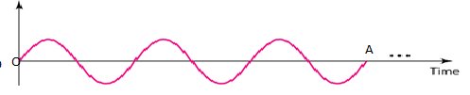
Analog Signals
Frequency is the number of cycles per second and is measured in Hertz(Hz). Frequency corresponds to the penetrating power of a signal
Period (T) is the time taken through a cycle
Frequency and period are the inverse of each other.
Example
Suppose that the wave in the figure below takes 0.001s from O to A. Determine
  The frequency =no. of waves/time=3.5/0.001=3500Hz
  Period of the wave =1/f=1/3500=0.000286s

Slide 6

Analog Signals
Amplitude is the maximum displacement of a wave from its original position. It corresponds to the strength of the wave. It is measured in metres (m)
Amplitude of a wave corresponds to the strength of the wave
Phase describes the position of the waveform relative to time 0.
Three sine waves with the same amplitude and frequency, but different phases

Slide 7
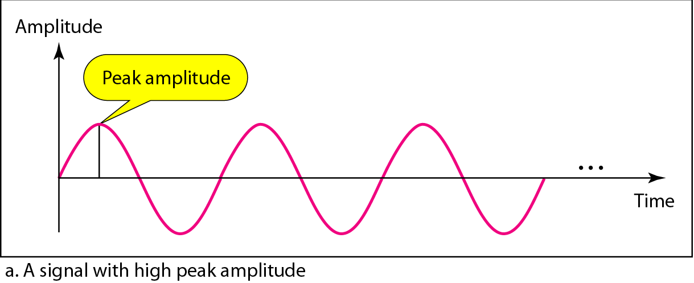
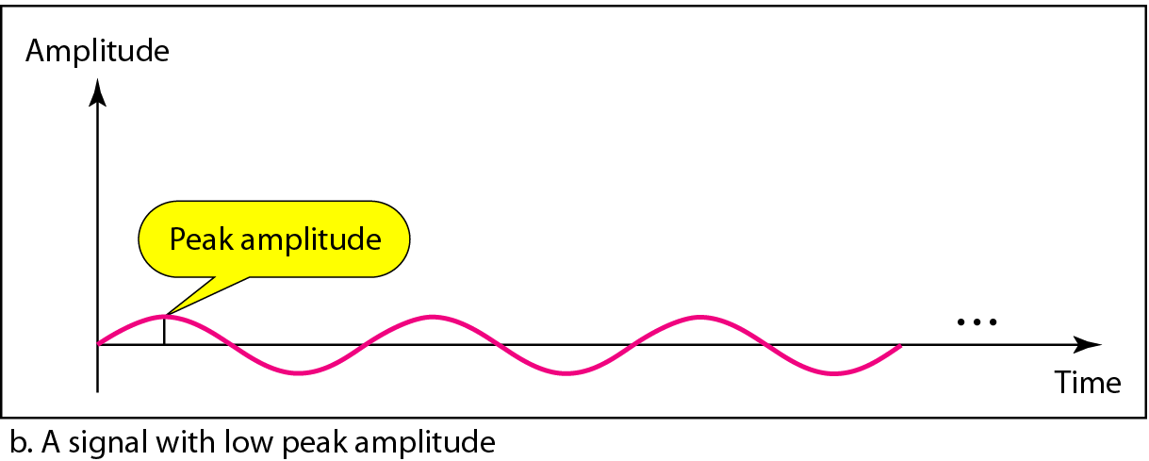
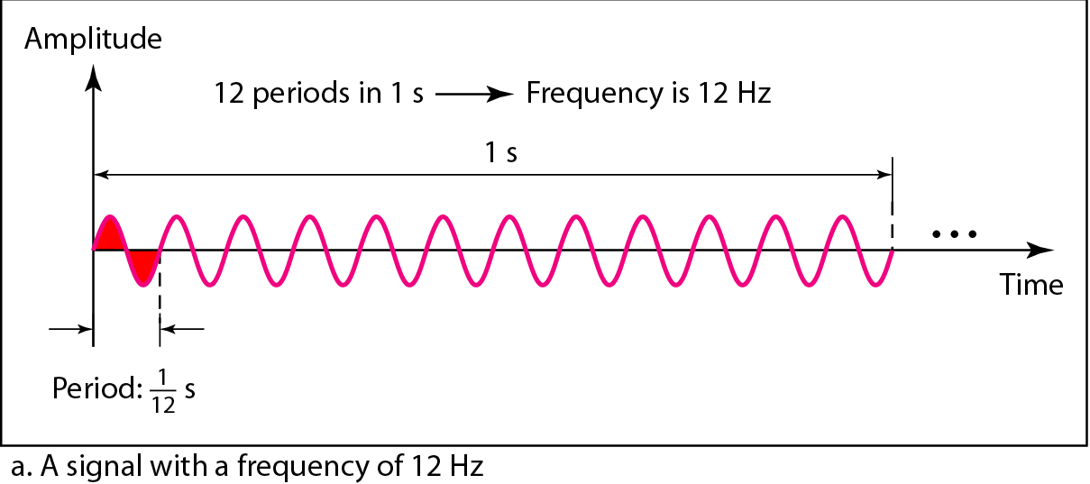
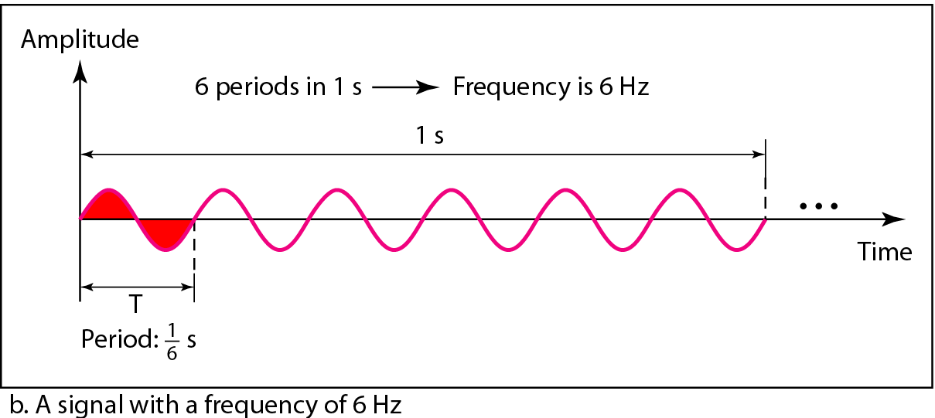

Periodic Analog Signals
Two signals with the same phase and frequency, but different amplitudes
Two signals with the same amplitude and phase, but different frequencies
Units of period and frequency
3.<number>

Slide 8


Example
Suppose the power we use at home has a frequency of 50Hz. Determine the period of this sine wave
Example
Express a period of 100 ms in microseconds.
Solution
From Table we find the equivalents of 1 ms (1 ms is 10⁻³ s) and 1 s (1 s is 10⁶ μs). Convert ms to s then to μs. Thus
Example
The period of a signal is 100 ms. What is its frequency in kilohertz?
Solution
First we change 100 ms to seconds, and then we calculate the frequency from the period (1 Hz = 10⁻³ kHz).

Slide 9

Digital Signal
In addition to being represented by an analog signal, information can also be represented by a digital signal. For example, a 1 can be encoded as a positive voltage and a 0 as zero voltage. A digital signal can have more than two levels. In this case, we can send more than 1 bit for each level.
Number of bits per level =log₂(M); where M is the number of levels
Two digital signals: one with two signal levels and the other with four signal levels
3.<number>

Slide 10
Every binary digit/bit is a pulse. Eight bits form a byte (a character).
A character include
  A digit (e.g. 9, 4 and 0),
  A letter of the alphabet (e.g. a, B and Z),
  A symbol (µ, b and p)
  Special characters (~, - and %)
  And the spaces included. The first line of this page has 95 characters
Computers read and write information e.g. program instructions in bits and bytes because of its on/off state of electrical circuits.
The number of pulses (1 or 0) in one second is called a baud. The baud rate is twice the frequency.
The rate at which data flows is called data transfer rate expressed in bits per second (or mbps, kbps etc).

Slide 11
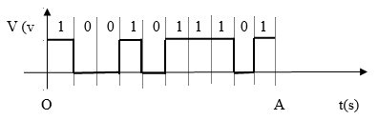
Example
The digital signal shown in the graph below takes 0.001s to be transmitted from O to A
A
    speed in bps =bits/time=10/0.001=10000bps
    frequency of the signal=1/2speed=1/2×10000 =5000Hz if it was to be converted to an analog signal

Slide 12


Example
A digital signal has eight levels. How many bits are needed per level? We calculate the number of bits from the formula:
Each signal level is represented by 3 bits.
Example
A digital signal has nine levels. How many bits are needed per level? We calculate the number of bits by using the formula.
Each signal level is represented by 3.17 bits. However, this answer is not realistic. The number of bits sent per level needs to be an integer as well as a power of 2. For this example, 4 bits can represent one level.
Example
Suppose the line “an analog signal is characterized by amplitude (A), wavelength (λ) frequency (f), period (T) and phase (θ).” takes 0.001s to be transmitted across a network. Determine the data transfer rate of the network (assume that there is no system delays)

Slide 13

Transmission of a Digital Signal
We can transmit a digital signal by using one of two different approaches:
baseband transmission.
broadband transmission (using modulation).
Baseband transmission means sending a digital signal over a channel without changing
the digital signal to an analog signal. Figure shows baseband transmission.
Figure
Baseband transmission
A digital signal is a composite analog signal with an infinite bandwidth.
Baseband transmission requires that we have a low-pass channel, a channel with a bandwidth that starts from zero. This is the case if we have a dedicated medium with a bandwidth constituting only one channel. For example, the entire bandwidth of a cable connecting two computers is one single channel. As another example, we may connect several computers to a bus, but not allow more than two stations to communicate at a time.
If the available channel is a bandpass channel, we cannot send the digital signal directly to the channel; we need to convert the digital signal to an analog signal before transmission.

Slide 14
Analog and Digital Signals Contrasted
Analog signal Digital signal
Values vary continuously values remain constant
Classified as periodic/non-periodic classified into levels
Characterized by f, T, A, λ, Ɵ characterized by pulse and baud
Uses broadband channel uses baseband bandwidth
Requires a band-pass channel require a low-pass channel
(frequency starts any point) (frequency starts from base, 0)
Allow multiple frequencies transmits only one signal at a time
Result to low quality signals transmit high quality signals
Transmitted over long distance short distance (at the LAN side)
Slow fast
Expensive cheap

Slide 15

Transmission Impairment
Signals travel through transmission media, which are not perfect. The imperfection of a medium causes signal impairment. This means that the signal at the beginning of the medium is not the same as the signal at the end of the medium. What is sent is not what is received. Three causes of impairment are attenuation, distortion, and noise.

Slide 16

Attenuation
Is the loss of signal energy.
Caused by conversion of carrier energy (electrical, light, airwaves) to other forms of energy e.g. heat, sound, light
The remedy is to use an amplifier for an analog or repeaters/switches (boosters) for digital signals

Slide 17

Distortion/Latency (signal delay)
Is the loss of signal form or shape due o signal delay.
Distortion can occur in a composite signal made of different frequencies. Signals arrive out of phase
Caused by internal resistance of a medium (wire), therefore copper wires are mostly used since they have a low resistance
Also caused by the many boosters needed to remedy signal attenuation, therefore boosters between source and destination can be reduced by using a high speed medium that does no require repetition (e.g. fibre optic cable)

Slide 18

Noise
Is an unwanted signal (wanted signals are either the data or the carrier signals; others are interferences, may corrupt the signal) such as
thermal noise, or heat energy caused by internal resistance of a medium
induced noise, or electromagnetic interference (EMI) caused by current carrying conductor
crosstalk, the infringement of a signal in one wire onto then signal in an adjustment wire
impulse noise, or a surge is a signal with high energy in a very short time that comes from power lines, lightning, and so on
Others include echo, white, jitter,

Slide 19
Signal-to-Noise Ratio (SNR)
Presence of noise in a media affect signal flow
Signal-to-Noise Ratio is the effect/impact of noise on signal transmission
That is, SNR = average signal power \average noise power
SNR is actually the ratio of what is wanted (signal) to what is not wanted (noise).
SNR is just a value with no units
A high SNR means the signal is less corrupted by noise; a low SNR means the signal is more corrupted by noise.
SNR and noise(N) in Bells(B) is related thus; N =SNRlog₁₀ or SNR=10^{N}

Slide 20
Maximum Data Rate of a Channel
A very important consideration in data communications is how fast we can send data, in bits per second, over a channel. Data rate depends on three factors:
1. The bandwidth (B) or the frequency range (f₁-f₂)Hz available
2. The number of signal levels(M) used
3. The quality of the channel (the level of noise(N)) in Bells
For a noiseless channel, the Nyquist bit rate formula defines the theoretical maximum bit rate
C = 2Blog₂M
Where C is capacity/bit rate in bps, B is bandwidth (f₁-f₂) in Hz, M is the number of signal levels. M=2 by default

Slide 21
Example
Consider a noiseless channel with a bandwidth of 3000 Hz transmitting a signal with two signal levels. The maximum bit rate can be calculated as
Solution:
given B=3000Hz, M=2, C=?
Using Nyquist the
C = 2Blog₂M
=2×3000×log₂2 ↔2=2¹
= 2×3000×1
=6000bps
Example
Suppose the same noiseless channel transmitting a signal with four signal levels (for each level, we send 2 bits). The maximum bit rate can be calculated as?
Solution:
given B=3000Hz, M=4, C=?
Using Nyquist theory
C = 2Blog₂M
=2×3000×log₂4 ↔4=2²
= 2×3000×4
=12000bps

Slide 22
Example
Suppose we need to send 265 kbps over a noiseless channel with a bandwidth of 20 kHz. How many signal levels do we need?
Solution
C=265kbps=265000bps, B=20kHz=20000Hz, M=?
From Nyquist theory
C = 2Blog₂M;
265000= 2×20000×log₂M
log₂M=6.625↔M=2^{6.625}
=98.7, but 64≤98.7≤128 levels
Since this result is not a power of 2, we need to either increase the number of levels or reduce the bit rate. If we have 128 levels, the bit rate is 280 kbps. If we have 64 levels, the bit rate is 240 kbps.

Slide 23
Shannon Capacity
In reality, we cannot have a noiseless channel; the channel is always noisy.
Claude Shannon introduced a formula, called the Shannon capacity
States that C= Blog₂(1 + SNR)
Applies for a noisy channel

Slide 24
Example 1
Consider an extremely noisy channel in which the value of the signal-to-noise ratio is almost zero. Determine the capacity of the channel.
Solution
Given SNR →0, C=?
From Shannon’s theory
C= Blog₂(1 + SNR)
=B×log₂(1+0)
=B×log₂1 ↔1=2⁰
=B×0
=0
This means that the capacity of this channel is zero regardless of the bandwidth. In other words, we cannot receive any data through if a channel is extremely noisy

Slide 25
Example 2
Determine the capacity of a telephone line with a bandwidth of 3000Hz and a signal-to-noise ratio of 3162.
Solution
Given B=3000hz, SNR=3162, C=?
From Shannon’s theory
C= Blog₂(1 + SNR)
C=3000×log₂(1+3162)
=3000×log₂3163
=3000×log_{l0}3163/log₁₀3163
=34881.2bps

Slide 26
Example 3
What is the capacity of a 36dB noisy and with a 2MHz bandwidth channel?
Solution
Given N=36db=36/10B=3.6B,
B=2MHz=2000000Hz, C=?
From Shannon’s theory,
C= Blog₂(1 + SNR);
but SNR=10^{N}=10^{3.6}=3981.1
֒C=2000000×log₂3982.1
C=2000000 ×log₁₀3982.1/log₁₀2
=23918627.4bps or 23.4mbs

Slide 27
.
Example
Example

Slide 28
Assignment
What is the channel capacity of a channel of bandwidth is 1000 Hz with 8 signal levels?
Determine the maximum capacity of a complex low-pass signal of 10 kHz
Determine the maximum capacity of a 3000Hz bandwidth channel with thermal noise of 30 dB
4. Suppose that the spectrum of a communications channel is between 3 MHz to 4 MHz with a noise power of 24dB.
a) Find the channel capacity (in the presence of noise, of course):
b) If there were no noise, how many signal levels would be needed to achieve the above channel capacity?
c) Determine the number of bits per level as in b) above
5. The line below is a message send over a network:
Main memory is divided into two types: 1. RAM (Random Access Memory) which can be altered by the CPU (read and write), 2. ROM⇨ (Read Only Memory) which the CPU can only read from (not write to)
Suppose that the message takes 5µs to be transmitted over the network, determine
  a) data transfer speed in bps
  b) baud in kbps
  c) time taken to download the document if a 10mbps MODEM is used? (assume that there is no system delay)

